Slide 1
Assignment 2
Create a mashup consist of
1 Grid which should display the attributes of change request using infoengine
2 Grid which should display the states of the change request and there count
3 Create a Pie chart which will display the state vise count in the mashup

Slide 2
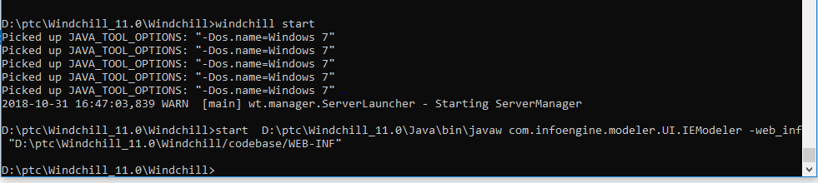
Start infoengine (launch cmd) in windchill shell-(start D:\ptc\Windchill_11.0\Java\bin\javaw com.infoengine.modeler.UI.IEModeler -web_inf "D:\ptc\Windchill_11.0\Windchill/codebase/WEB-INF“)

Slide 3
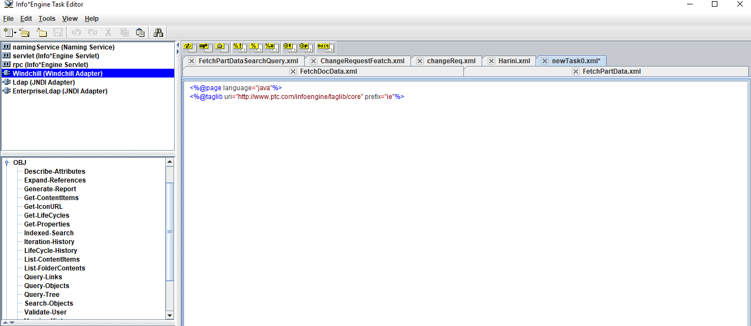
Create new task→Windchill→OBJ→Query-Objects(Double click n click on the editor)

Slide 4
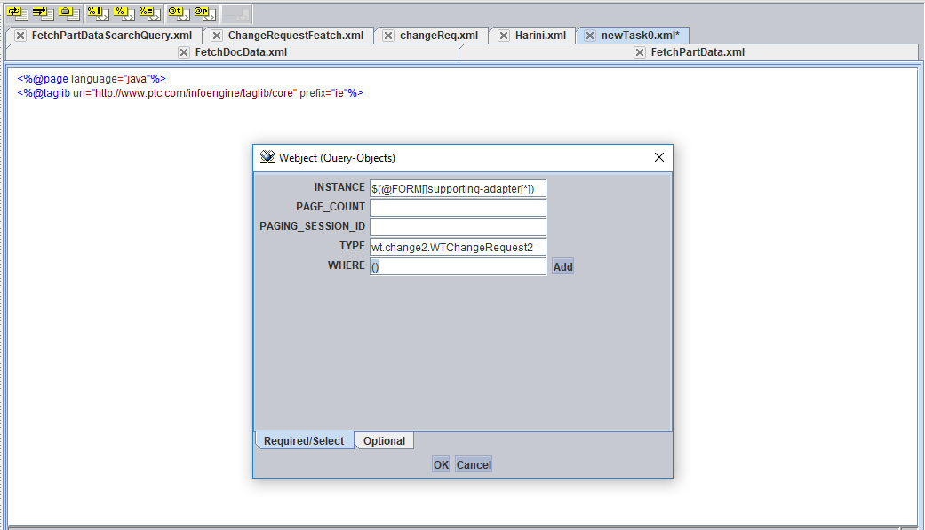
Type=wt.change2.WTChangeRequest2 Where=(){ie fetch everything}

Slide 5
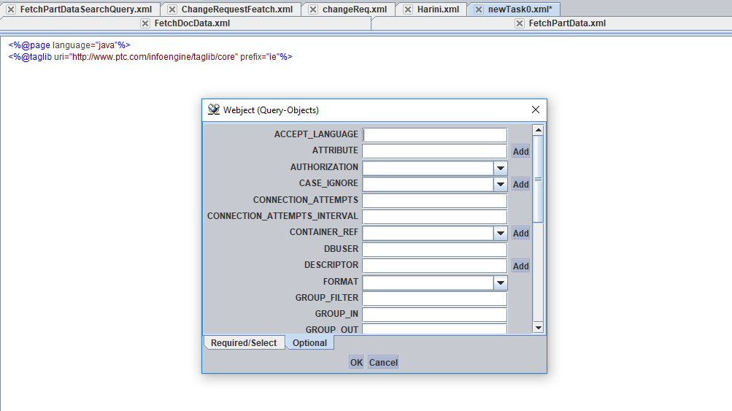
Optional Tab Add the required attributes(name,number,state.state,category(internal name)) (if not specified it fetch all the attributes)

Slide 6
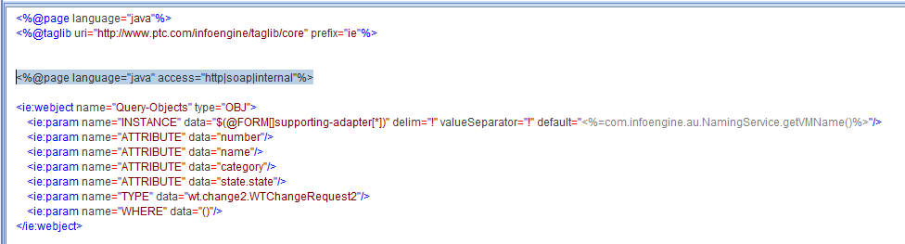
To overcome forbidden exception in service(thingworx) add this cmd <%@page language="java" access="http|soap|internal"%>

Slide 7
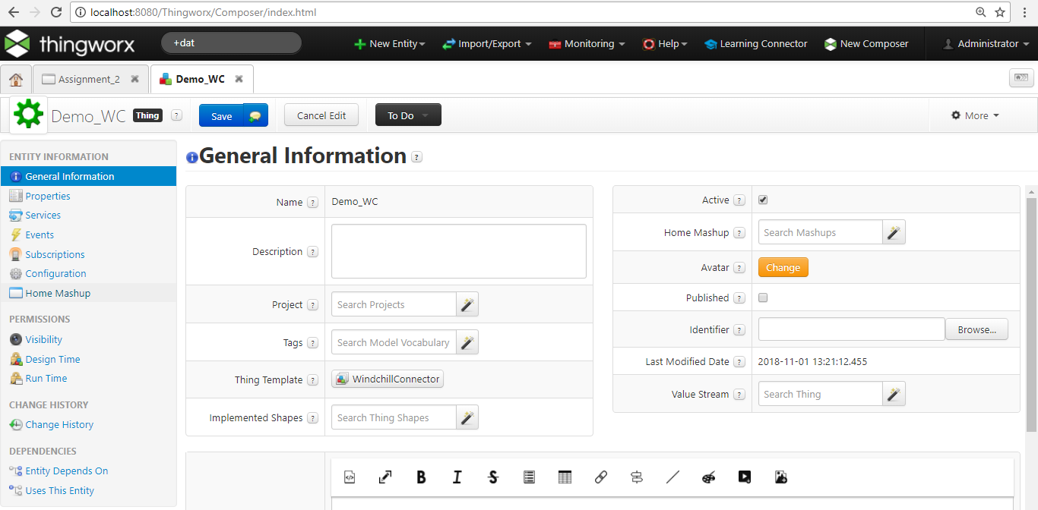
Thingworx platform -create thing

Slide 8
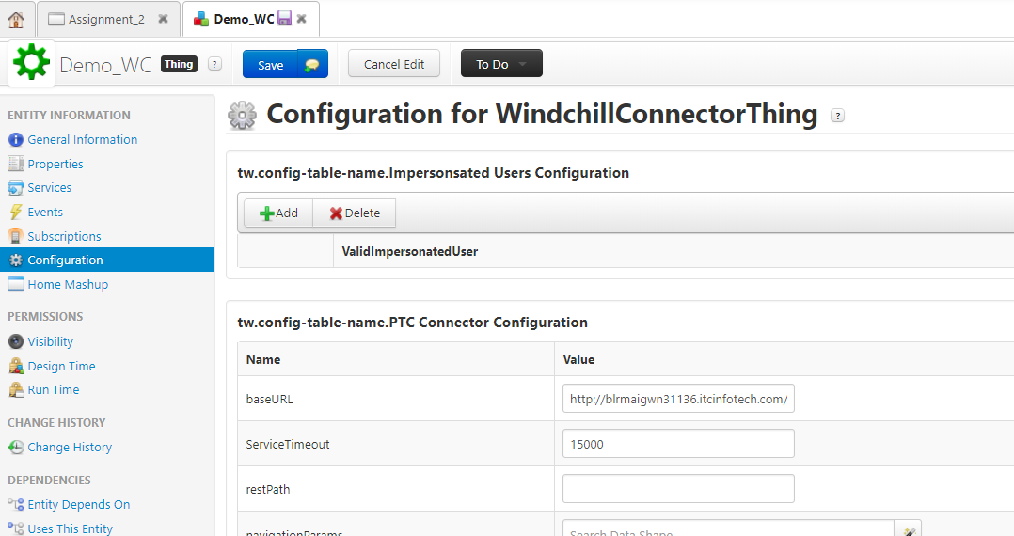
Configuration→baseUrl

Slide 9
Go to thingworx platform create 2 services 1 to fetch the change request 2 to get the state count of the change request

Slide 10
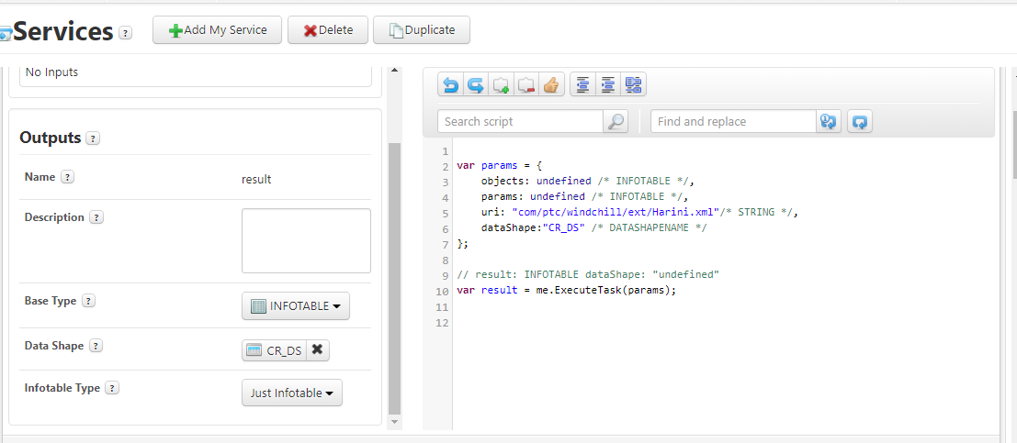
GetChangeRequest service uri-(map to the service written in infoengine(ExcecuteTask method))

Slide 11
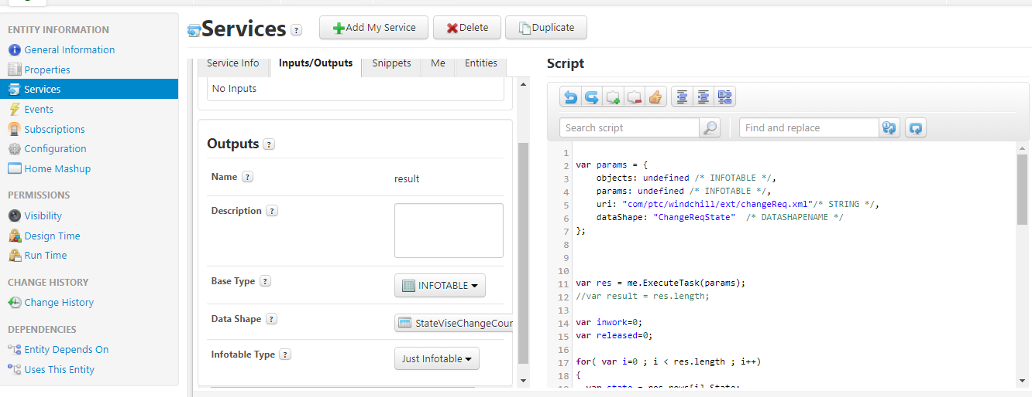
GetCR service output-infotable(state,count)

Slide 12
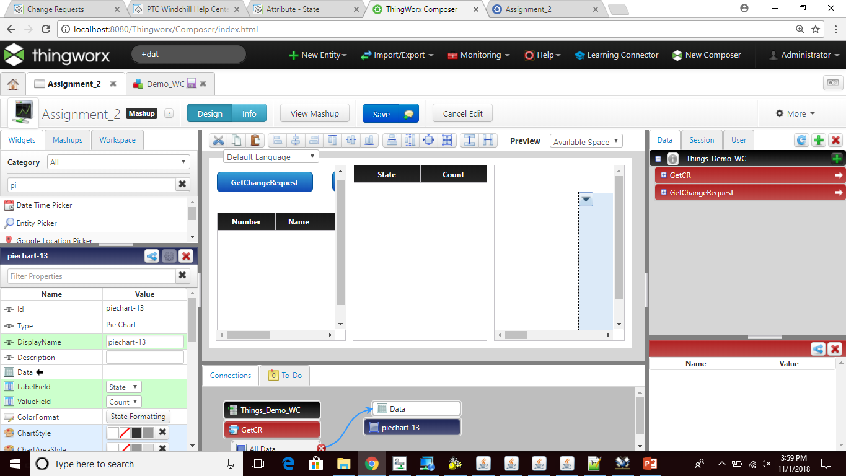
Create a mashup as follows

Slide 13
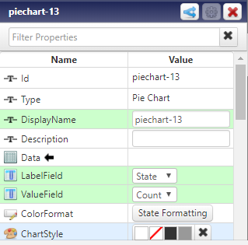
Pie chart-specify label and value field

Slide 14
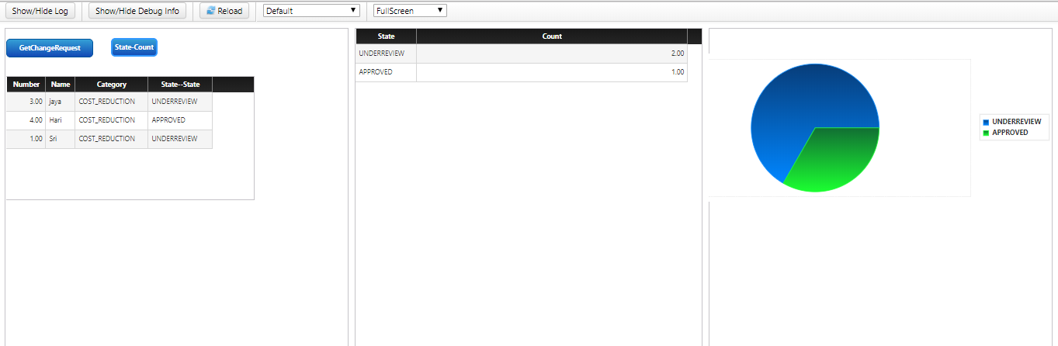
Final mashup looks like

